Slide 1
Admin & Business Service Council

Slide 2
Standing Agenda
Projects and policies
Significant changes or outages to services
Concerns from campus regarding IT services
Continual improvement
Metrics and information

Slide 3
Projects and policies
Update: RFP for Student Assistant project (Rob Caffey)
Update: CRM consolidation effort (Rob Caffey)
New: TeamDynamix – Current status and how KU is moving forward (Rob Caffey)
Policy updates (Tom Roderick)

Slide 4
Project Updates Rob Caffey
RFP for Student Assistant
CRM consolidation effort
TeamDynamix – Current status and future

Slide 5
Policy Updates Tom Roderick
Update: Bring your own device (BYOD) Policy
Update: Data Classification and Handling Policy
New (August / September)
Network Policy
Telecommunications Physical Infrastructure Policy

Slide 6
Significant changes or outages
New: Read receipts in Microsoft Teams (Anne Madden Johnson)
Update: HCM 9.2 upgrade (Gregg Holcomb)
Major Incidents (Tom Roderick)

Slide 7
Significant Change to Service Anne Madden Johnson
Faculty member has requested ‘read receipts’ in Microsoft Teams
KU IT would like to have a broader conversation on this functionality

Slide 8
Significant Change / Outage to Service Gregg Holcomb
HCM 9.2 upgrade project status
Scheduled to start September 9th at 5:00pm, run through to September 14th

Slide 9
Major Incidents Tom Roderick
Some authentication services unavailable, with rolling failures. (July 19, 2021, starting at 10:35am). Server crash, was rebooted. Resolved: 10:55am
Issues with Oracle Cloud Services, DNS failures connecting to OCS (July 22, 2021, starting at 10:41am). Global vendor issue, vendor service failed. Reported resolved at 12:35pm.
Wireless internet down in Spencer Museum of Art (August 13, 2021, starting at 8:42am). Maintenance on APs overnight caused outage. Resolved: 8:55am.
Network outage at Edwards Campus (August 12, 2021, starting at 10:46pm). Overnight storms knocked out power, main router was rebooted. Resolved: August 13, at 9:55am.
Several major KU websites (including admissions.ku.edu) causing errors (August 14, 5:58am). Database cache full. Resolved: 6:40am

Slide 10
Concerns from campus
Opportunity for members to share thoughts / feedback

Slide 11
Continual Improvement
What can we include in this meeting to make it more beneficial?
What can we do to make this worth the time?

Slide 12
Metrics and information

Slide 13
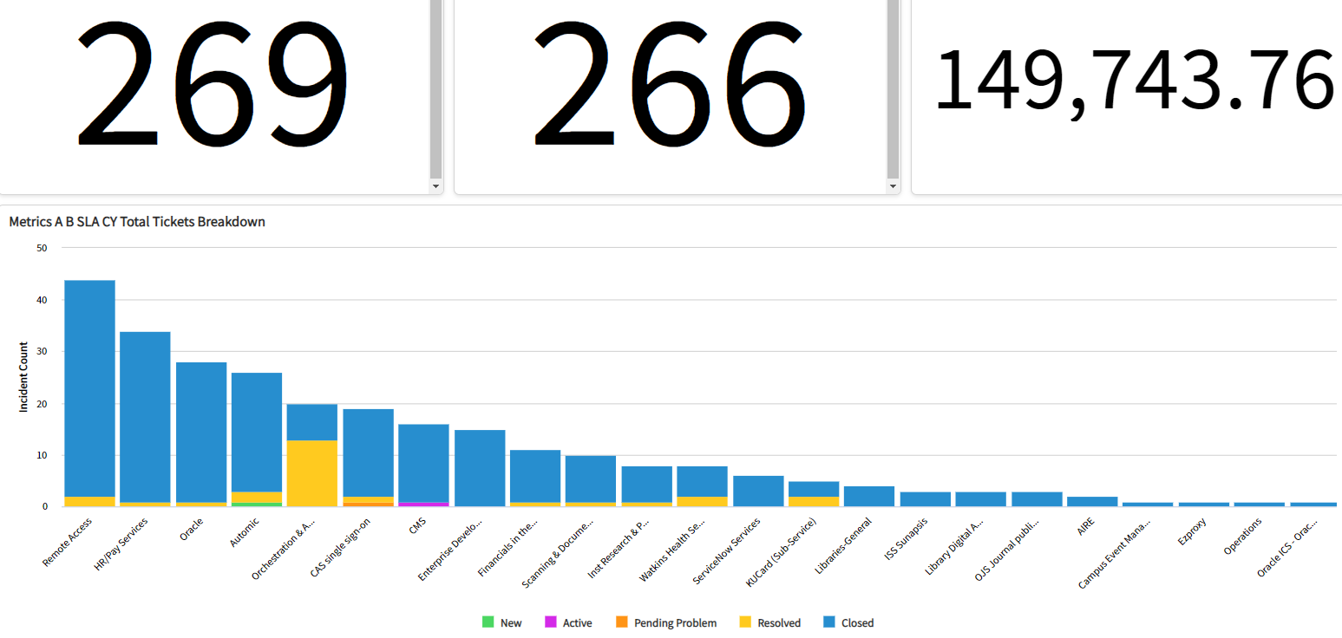

Slide 14
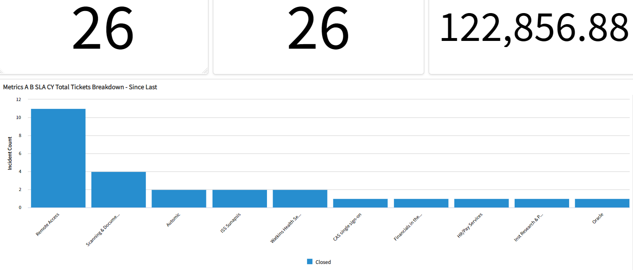

Slide 15
Thank you.

