Slide 1
Admin & Business Service Council

Slide 2
Standing Agenda
Projects and policies
Significant changes or outages to services
Concerns from campus regarding IT services
Continual improvement
Metrics and information

Slide 3
Projects and policies
Update: Recap of HCM 9.2 Upgrade (Rob Caffey / Gregg Holcomb)
Tax updates and PUM schedule
Update: Digital Asset Management Solution (Breana Kohler)
New: Project Management Software (Tom Roderick)
New: KU Lawrence Campus-wide Space Scheduling Tool (Melissa Smith)

Slide 4
Project Updates
HCM 9.2
Digital Asset Management Solution
Project Management Software

Slide 5
KU Lawrence Campus-Wide Scheduling Tool
The impetus for this project comes from the Provost’s Administrative Services Review that took place in spring, 2021. One of the recommendations, associated with space, was to implement a universal space scheduling tool. KU has several different programs, apps, and resources that accommodate with scheduling the various types of space across campus. Ideally, we would have one, robust, holistic space scheduling solution that meets the following criteria:
Single-sign-on users can personally reserve any space on campus (certain room types will have restrictions and will require a certain level of access). Examples of spaces that can be reserved are as follows: event spaces, conference rooms, special-use rooms (i.e. lactation rooms, reflection spaces, hoteling office spaces), and any other rooms not reserved for class use
Either replaces the current classroom scheduling software or integrates with it
Can integrate with Maximo, Metasys, and Outlook
Has levels of user permissions
Has a search function where users can filter by room size, use-type, resources, etc
Naming conventions across all systems should align (scheduling tool, Outlook, Maximo, etc)

Slide 6
Significant changes or outages
New: High-level overview of efforts to streamline SSO services (Rob Caffey)
Major Incidents (Tom Roderick)

Slide 7
Significant Change to Service Rob Caffey
High-level overview of efforts to streamline SSO services

Slide 8
Major Incidents Tom Roderick
Enroll & Pay unavailable for some users. (August 23, 2021, starting at 11:03am). Integration and memory issues. Resolved: 1:25pm.
Voice services offline at KLETC. (September 01, 2021, starting at 9:04am). Voice provider changed IP, needed updating in KU systems. Resolved: 9:26am
Network outage at Edwards Campus (September 07, 2021, starting at 5:34pm). UPS failure on network. Reported resolved at 6:18pm.

Slide 9
Concerns from campus
Opportunity for members to share thoughts / feedback

Slide 10
Continual Improvement
What can we include in this meeting to make it more beneficial?
What can we do to make this worth the time?

Slide 11
Metrics and information

Slide 12
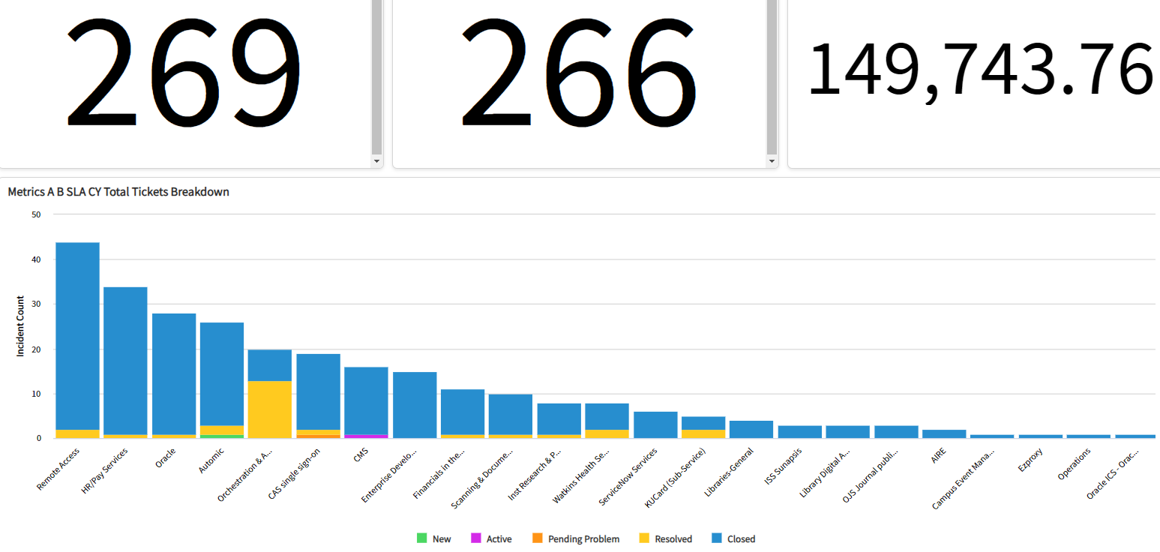
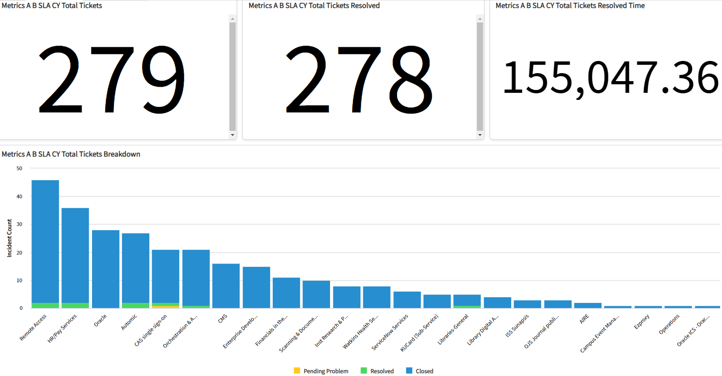

Slide 13
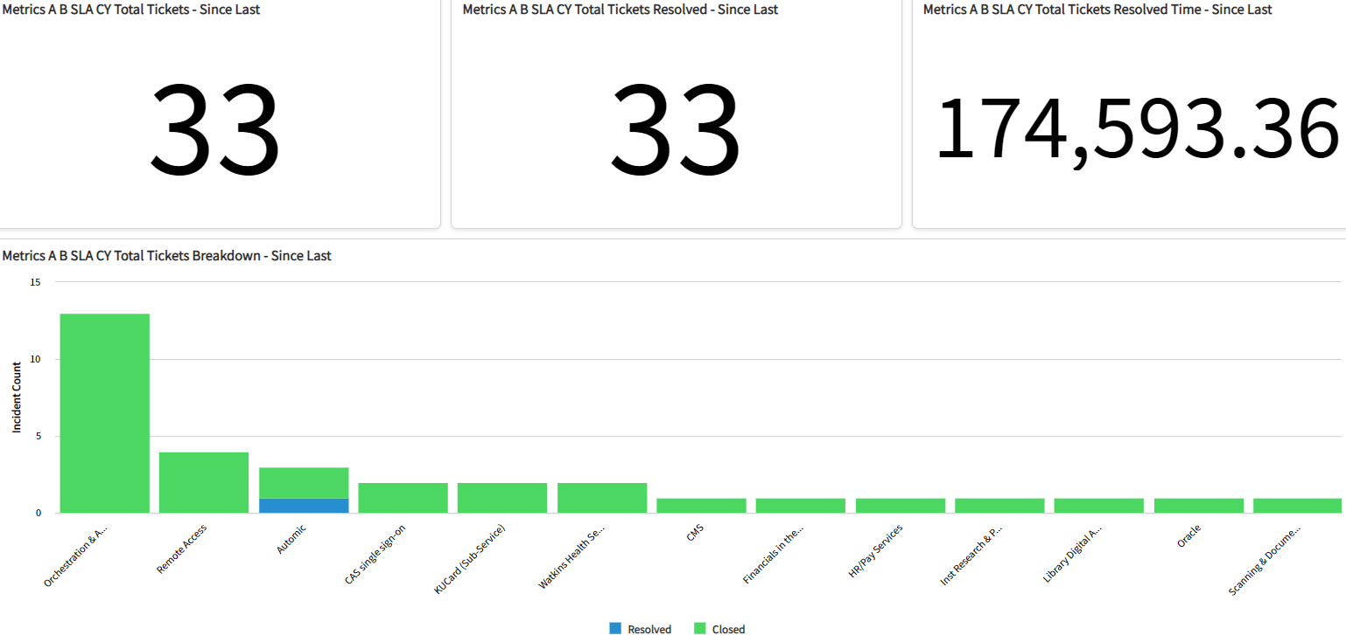

Slide 14
Thank you.

